Slide 1
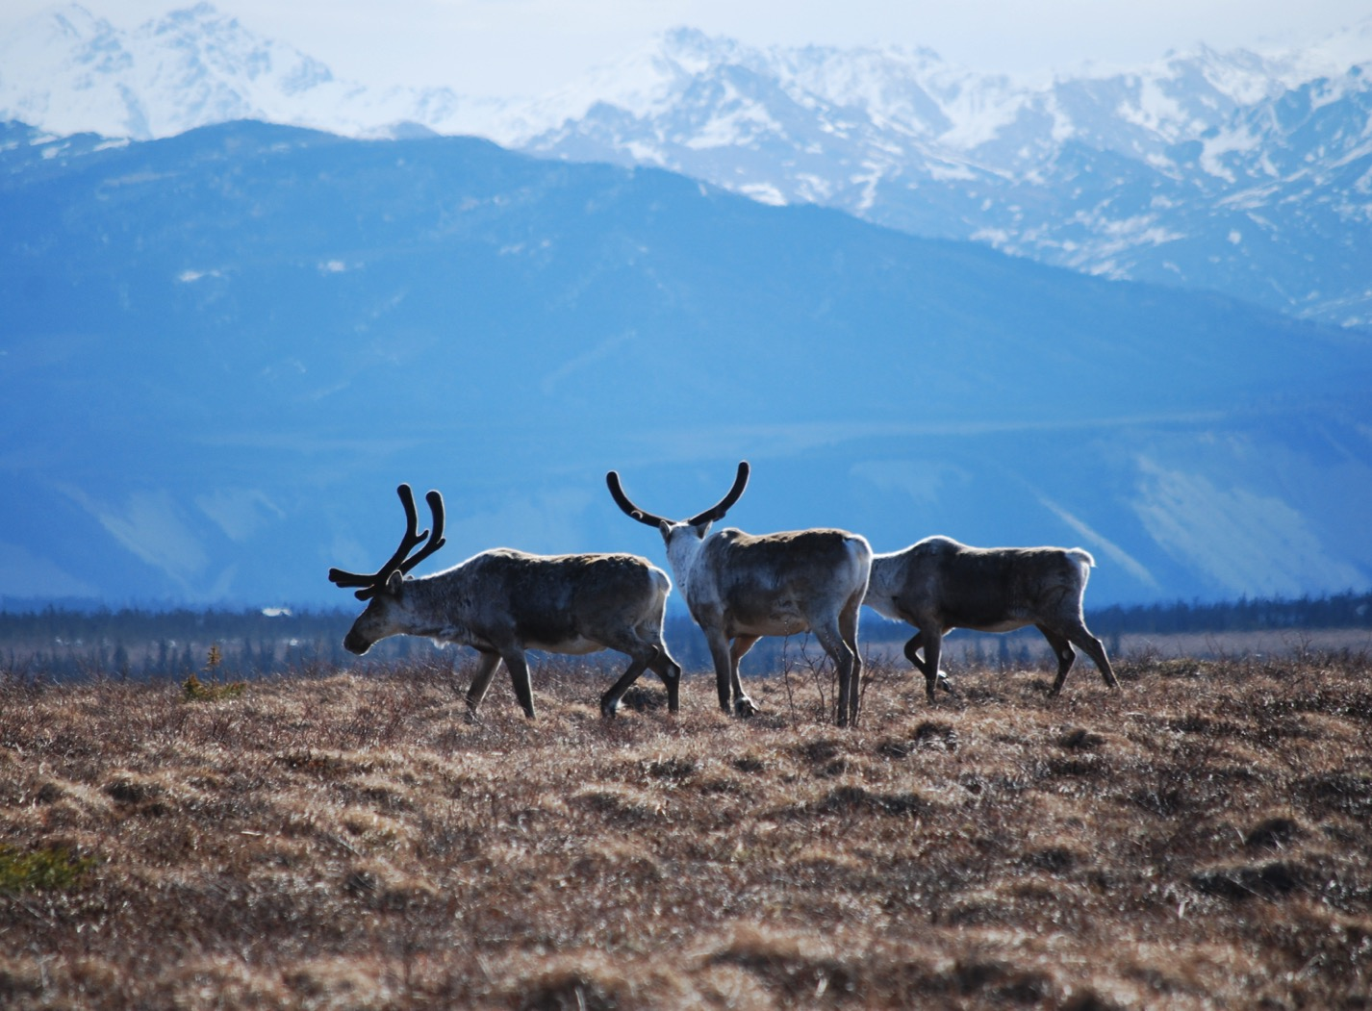
Arctic Boreal Vulnerability Experiment (ABoVE)
2017 ABoVE Airborne Campaign
21 June 2017 (DOY 172)
UAVSAR: North Slope
Charles Miller, Deputy Science Lead
Jet Propulsion Laboratory, California Institute of Technology
and the ABoVE Science Team For Hank Margolis, Eric Kasichke, Bruce Tagg
NASA HQ
2017

Slide 2
21 June 2017/DOY 172 North Slope
Daily Summary:
C-20A (N30502) UAVSAR ABoVE CAMPAIGN (CANADA / ALASKA)
REPORT DATE: 21 June 2017
Current Status of Aircraft: GREEN
Current Status of SAR: GREEN
Current Status of PPA: GREEN
Current Deployment Location: Fairbanks, Alaska (PAFA)
Crew: Asher, Barry, Griffith, Choi, T Miller, Tan
Science Coordinator: N Pinto
Science Lead: M Moghaddam
Project Manager: Y Lou

Slide 3
21 June 2017/DOY 172 North Slope
Daily Summary:
Science Flight (PAFA – PAFA #5) – 5.5 hours
Great flight
Collected 9 of 9 data lines
Atkasuk, Barrow, Anaktuvuk, Deadhorse, Yukon Flats
Flight Plan – 1141v02
All lines were acquired successfully; line 6 had to be repeated, otherwise no issues

Slide 4
21 June 2017/DOY 172 72-Hour Look Ahead
All plans weather dependent
Thursday 22 June 2017 (DOY 173):
Mackenzie Valley Reflight
Friday 23 2017 (DOY 174):
Transit to Palmdale

Slide 5
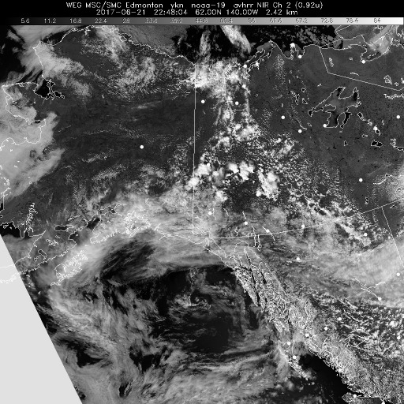
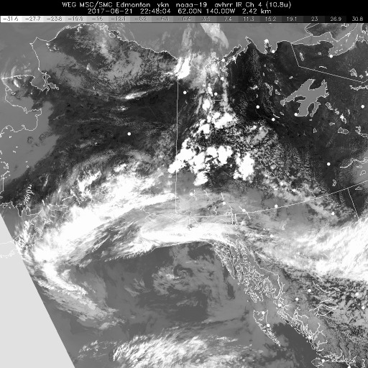
21 June 2017/DOY 172 North Slope
HRPT NIR
HRPT IR
HRPT Polar NIR (left) and IR (right) show patchy low level clouds across the North Slope

Slide 6
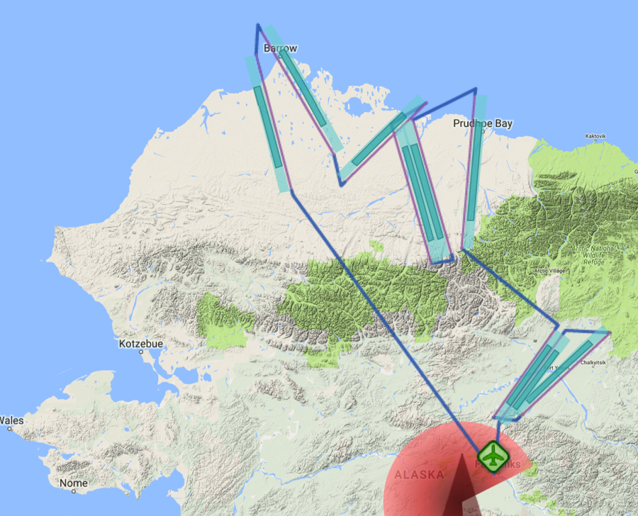
21 June 2017/DOY 172 North Slope
Flight Plan 1141 v02, Report 17069: Fairbanks AK (PAFA) – PAFA
https://uavsar.jpl.nasa.gov/cgi-bin/report.pl?planID=PLAN_17069#flightPlan
Data Acquisitions:
Line 1, ID 34509: Atqasuk
Line 2, ID 15018: Barrow
Line 3, ID 04603: CALM
Line 4, ID 16405: Anaktuvuk 1
Line 5, ID 34408: Anaktuvuk 2
Line 6, ID 18519: Deadhorse
Line 7, ID 21508: Yukon Flats 1
Line 8, ID 04707: Yukon Flats 3
Line 9, ID 21609: Yukon Flats 2
Based on P-band Plan 1117 v02
P-band keep-out zone shown in RED
(centered on Clear, AK: 64.29 N, 149.19 W)
15018
34509
04603
18519
16405
34408
21508
21609
04707
Notes:
modified flight lines to match P-band plan 1117_v02

Slide 7
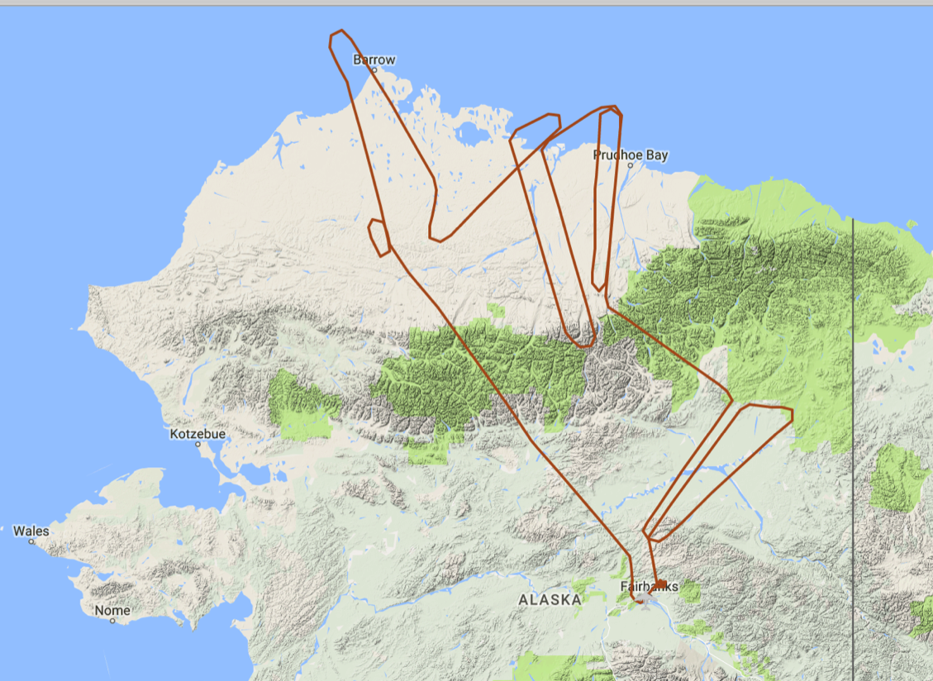
21 June 2017/DOY 172 North Slope
As-flown Lines
15018
34509
04603
18519
16405
34408
21508
21609
04707

Slide 8
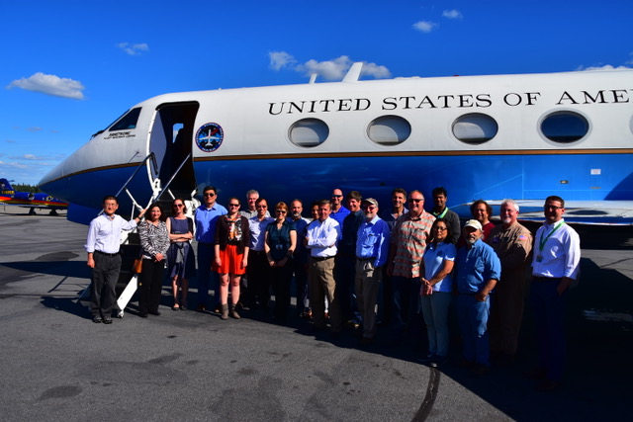
21 June 2017/DOY 172 North Slope
The Alaska Satellite Facility User Working Group
visited the UAVSAR plane and crew.
Stevens Village
Beaver
In-flight action

Slide 9
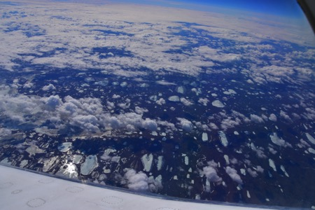
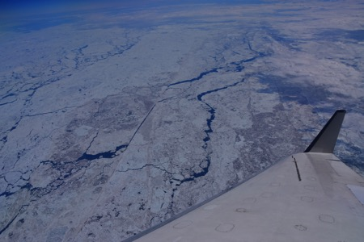
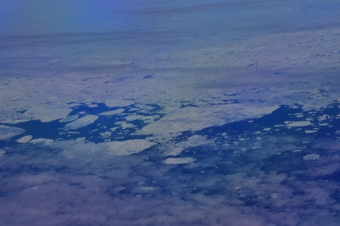
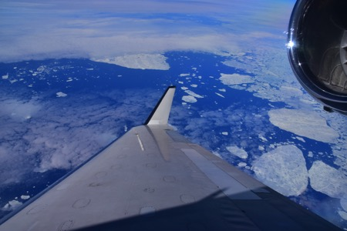
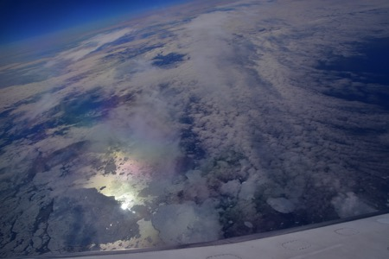
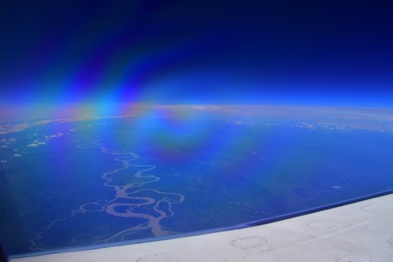
21 June 2017/DOY 172 North Slope
Stevens Village
Beaver
Sea ice near Barrow and Deadhorse contrasts with
the flowing waters of the Mighty Yukon

Slide 10
21 June 2017/DOY 172 North Slope
UAVSAR Quick-look products
A. Line 1, ID 34509_002: Atqasuk
B. Line 2, ID 15018_003: Barrow
C. Line 3, ID 04603_004: CALM
Joanne Shimada, JPL
A
B
C
Notes:
A. Note the transition (L to R) from North Slope uplands to the many lakes of the Arctic coastal plain
B. The area around Barrow (left hand side of the image
C. Ice still observed in the centers of several lakes (green) in the central Arctic coastal plain

Slide 11
21 June 2017/DOY 172 North Slope
UAVSAR Quick-look products
A. Line 4, ID 16405_005: Anaktuvuk 1
B. Line 5, ID 34408_006: Anaktuvuk 2
C. Line 6, ID 18519_008: Deadhorse
Joanne Shimada, JPL
A
B
C
Notes:
A&B: Overlapping samples of the Anaktuvuk River fire scar (opposite direction acquisitions) will be used to assess permafrost degradation
C: This swath covers the Dalton Highway and the myriad field measurements that have been performed along this route over the years

Slide 12
21 June 2017/DOY 172 North Slope
UAVSAR Quick-look products
A. Line 7, ID 21508_009: Yukon Flats 1
B. Line 8, ID 04707_010: Yukon Flats 3
C. Line 9, ID 21609_011: Yukon Flats 2
Joanne Shimada, JPL
A
B
C
Notes:
All of these swaths overlap with USGS EMI surveys of permafrost profiles in the Yukon Flats. They will also provide critical complementary information to the AirSWOT analyses of the wetlands structure in this area.

Slide 13
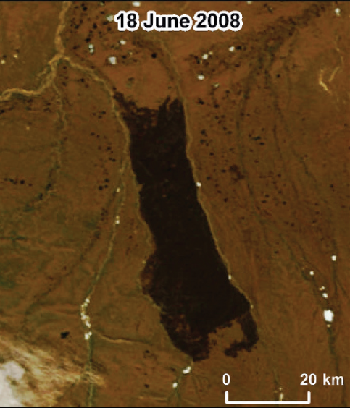
21 June 2017/DOY 172 North Slope
A
B
C
Jones et al., (2009)
Notes:
LEFT: UAVSAR north-south transects, Lines 16405 and 34408, reveal the large-scale features of the Anaktuvuk River fire scar. Repeat passes in August will enable interferomteric analysis of the permafrost state and estimates of active layer thickness across the burn scar.
RIGHT: MODIS image of the Anaktuvuk River fire scar: Jones et al., Arctic Antarctic Alpine Res 41, 309 (2009)

Slide 14
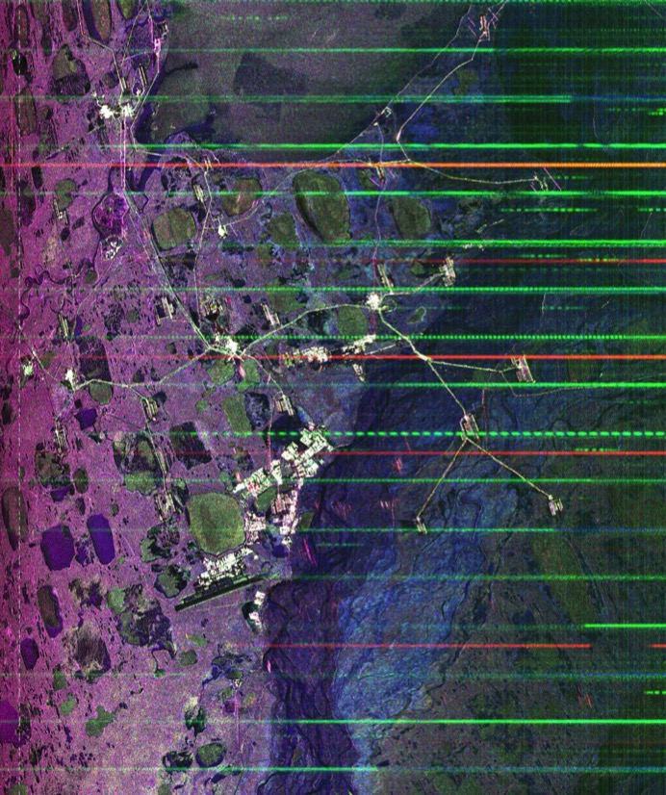
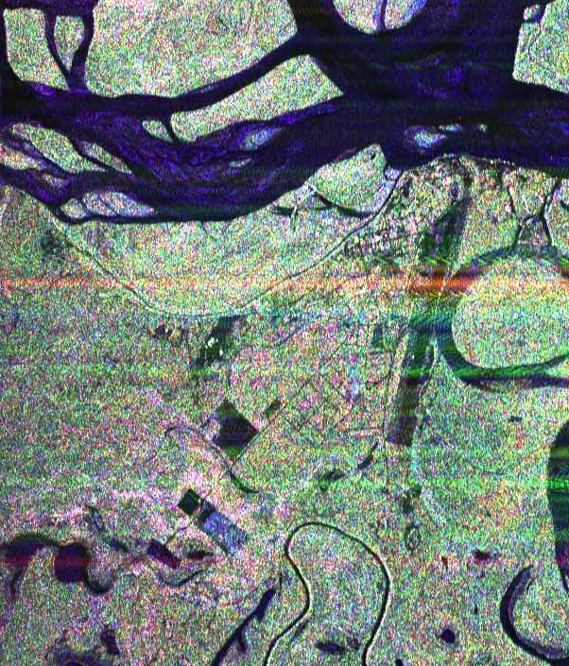
21 June 2017/DOY 172 North Slope
Deadhorse
Fort Yukon
A
B
C
Airstrip
Airstrip
Notes:
LEFT: Roads link the many oil & gas production pads in Deadhorse (detail from line 18519)
RIGHT: Fort Yukon infrastructure can be seen as the street grids and regular shapes below the Yukon River in this image (detail from line 04707)

